Slide 1

Battle of the Neighborhood in Long Isalnd, New York.
Adam Roberts
July 2020

Slide 2
Background: A man and his family is moving to Long Island due to a job transfer. The family would like to live in a single home and not in a busy area. Schools are not a big issue because they do not plan to have children. Issue: The move has to happen relatively quickly, and they have found a real estate agent who has been sending lots of homes with in 10-15 miles of the new office. They have 3 days to search for homes and want to narrow down the neighborhood in order to maximize the amount of time looking at homes.
Battle of the Neighborhood in Long Isalnd, New York.

Slide 3
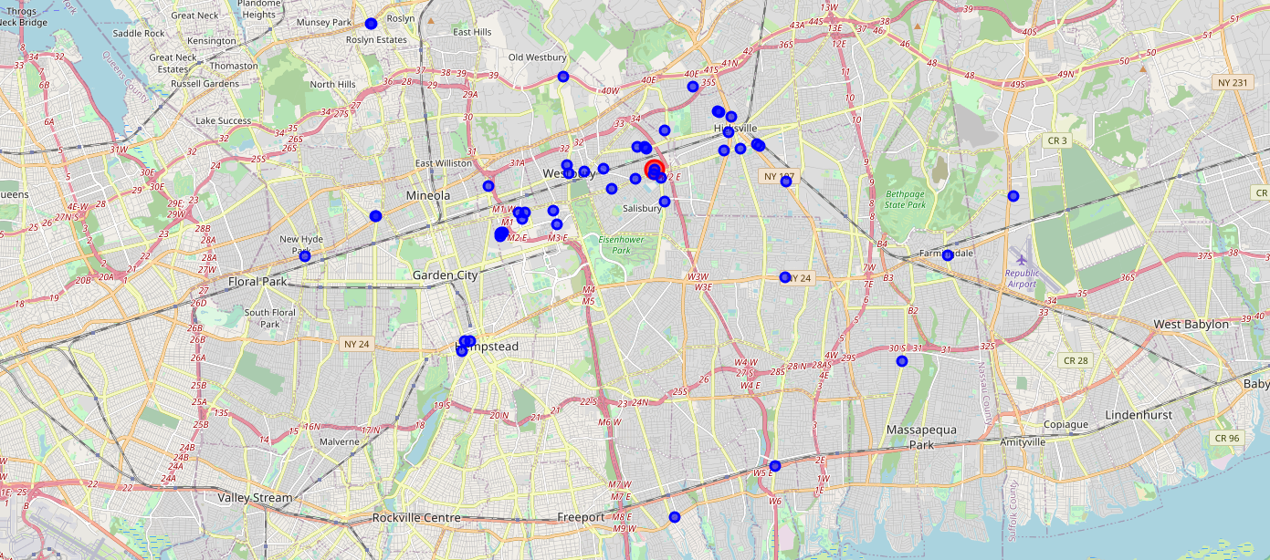
Legend
Venues -
Search for venues with in a 10 Mile radius of The new office building Identified 49 Venues.

Slide 4
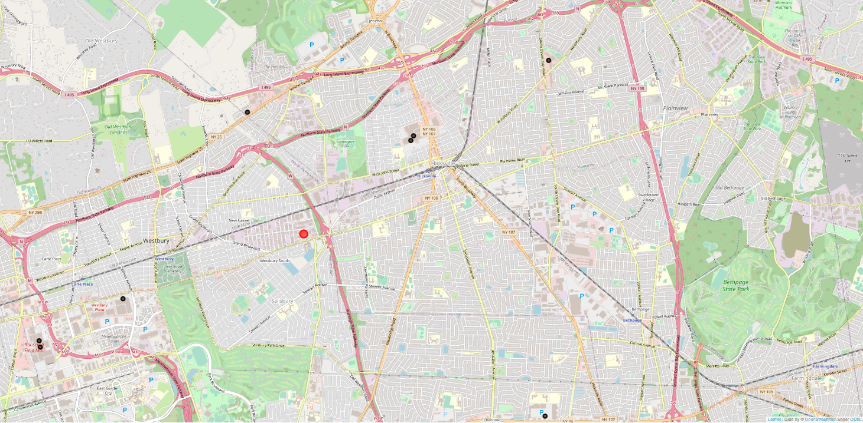
Legend
Malls -
Search for venues with in a 10 Mile radius of The new office building Identified 10 malls.

Slide 5
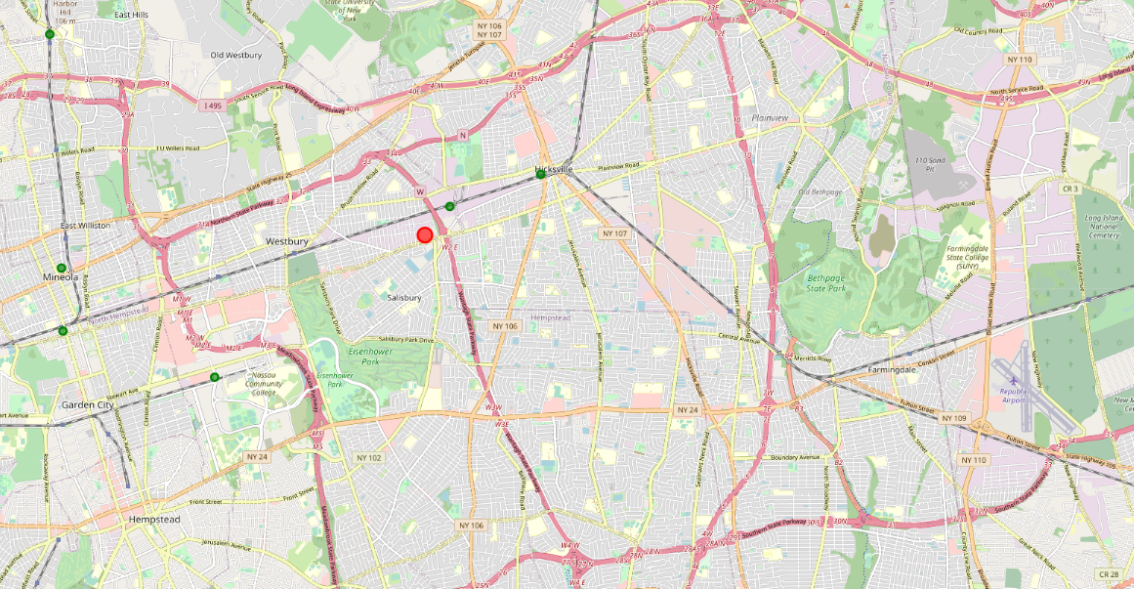
Legend
Trains -
Search for venues with in a 10 Mile radius of The new office building Identified 11 Train Stations.

Slide 6
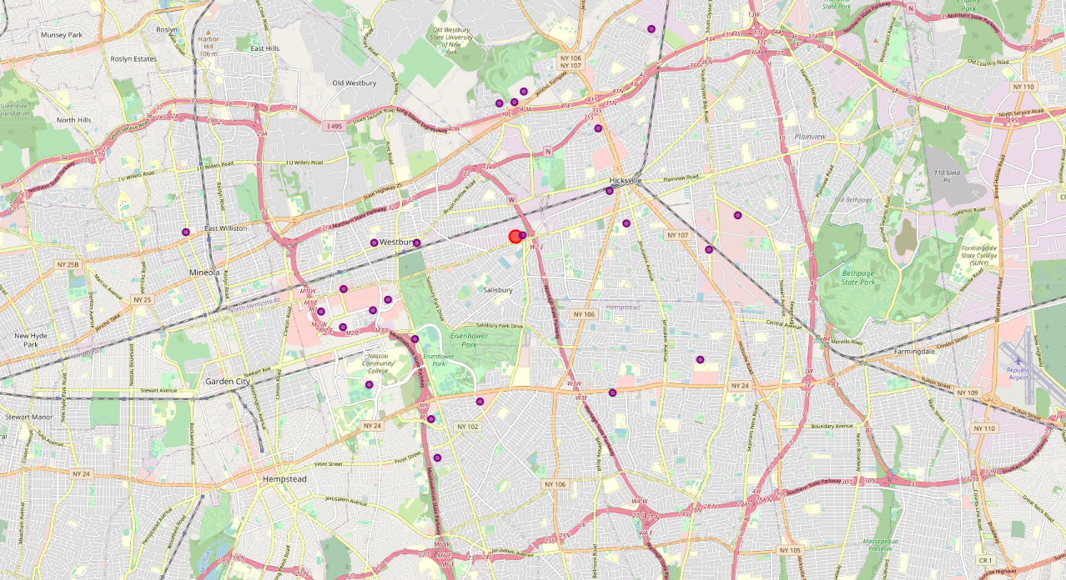
Legend
Gym -
Search for venues with in a 10 Mile radius of The new office building Identified 29 Gyms.

Slide 7
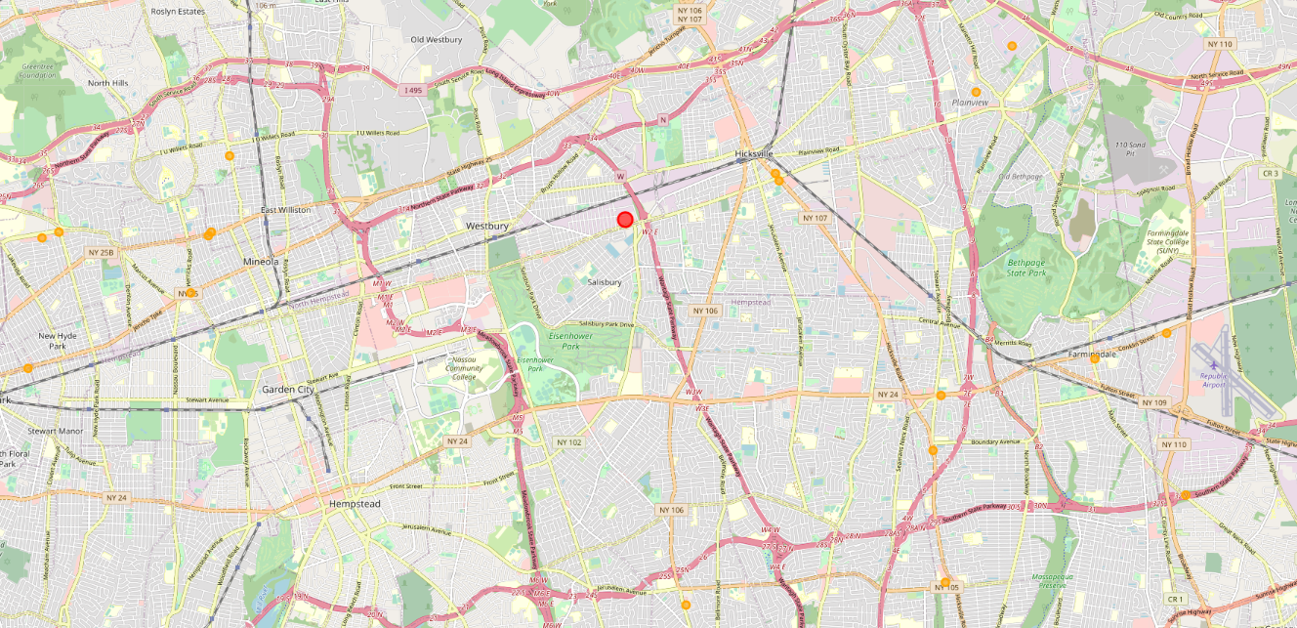
Legend
Hardware stores -
Search for venues with in a 10 Mile radius of The new office building Identified 26 Hardware stores.

Slide 8
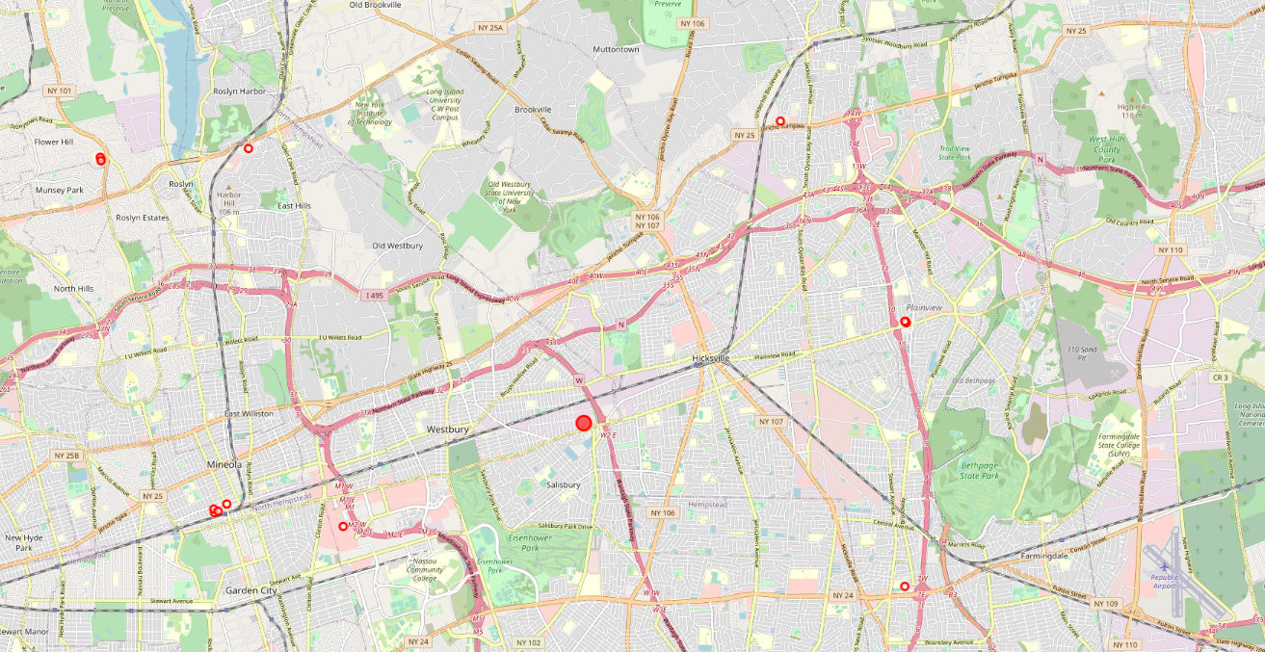
Legend
Hospitals -
Search for venues with in a 10 Mile radius of The new office building Identified 14 Hospitals.

Slide 9
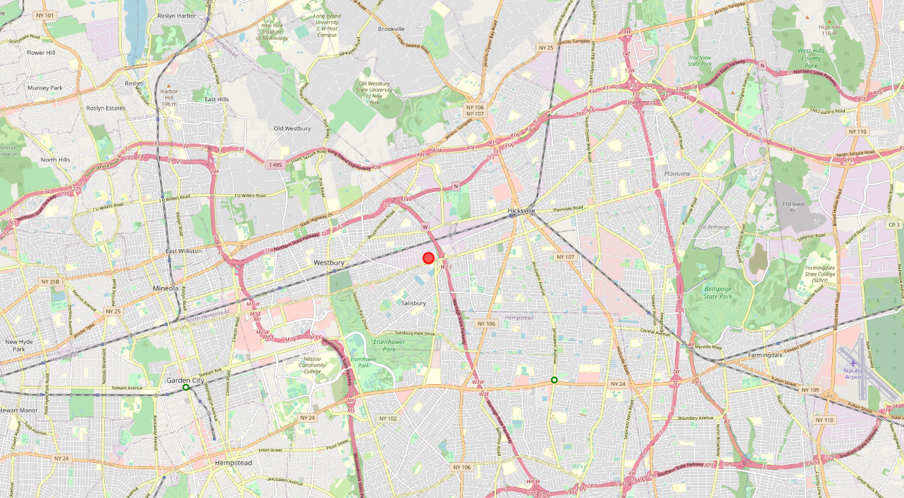
Legend
Gardens -
Search for venues with in a 10 Mile radius of The new office building Identified 2 Gardens.

Slide 10
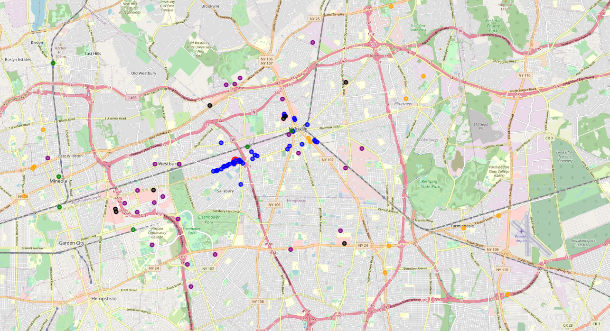
Legend
Venues –
Gyms –
Trains –
Gardens-
Malls-
Hardware-
Hospitals -
Combined locations within a 10 mile radius of the new building identified Hicksville the primary and westbury as the secondary locations where the family should look.

